Slide 1


An Evening of Bonsai
Session B: Bonsai Aesthetics
Alex Labram
October 2025
Nemeta Bonsai
nemeta.co.uk

Slide 2
Learning Outcomes
Theory
Be aware of the history and culture of bonsai
Understand (at a high level) how a bonsai is produced
Understand (at a high level) what distinguishes good and bad bonsai
Know how to maintain a bonsai on a day-to-day basis
Experience the key activities of re-potting, pruning and wiring
Be aware of inexpensive options for further learning and practice
Practical
Watering bonsai
Wiring a bonsai pot for re-potting
Exposing the nebari
Potting the prepared tree
Pruning for bulk, congestion and taper
Wiring for shape

Slide 3
Recap
Highlights of Evening A

Slide 4

Bonsai: Art & Science
Good bonsai practice is:
Authentic - makes you think “tree”
  Tree as biological / ecological process
Dramatic – makes you think “TREE”
  Tree as compositional element
Pragmatic – doesn’t make you think “dead tree”…
  Tree as living clay

Slide 5
I Had One Once, But It Died
What a bonsai needs to survive
Environment
  Indoor vs Outdoor
Watering!!!!!
  Single biggest killer of bonsai
  “Root hairs” die easily in drought
  Over-watering is also dangerous!
Light
Heat
  Dormancy
Airflow
Pest Control
  Animals: spider mites, scale bugs, aphids, caterpillars, vine weevil, squirrels
  Plants etc: pearlwort, liverwort, wood sorrel, pennywort, nostoc
  Caution: environmental issues!
Fertiliser
  “Balanced”: roughly even NPK
  Organic => micronutrients
  Caution: environmental & ethical issues!
Bonsai are far harder to keep alive than most common pot plants!

Slide 6
Authenticity & Drama
Thinking Like A Tree (That’s Seen Some S**t)

Slide 7
Arboriculture 101
What shapes a tree?
Sunlight
Airflow
Gravity / load
Shade
Animals

Slide 8
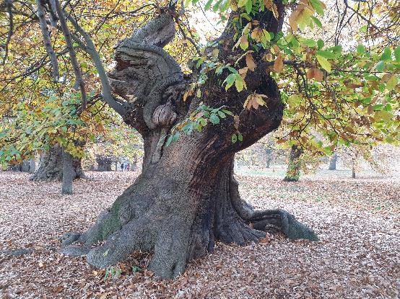
Authenticity & Age
What makes a tree look mature?
Canopy shape
  Rounded triangle
  Composed of rounded-triangle “pads” (for species that back-bud less readily)
Trunk & branch behaviour
  Short inter-node distance
  “Ramification”: fractal splitting of branches
  “Square-cube law”: big tree = proportionally heavier load = more curvature
  “Ruptures”: jagged direction changes
Texture
  Bark
  Dead-wood: advanced bonsai topic!
Taper
  “Nebari” (根張り) = root flare / buttress
  Trunk & branch flare: from base to apex / tip
  Trunk-to-branch (and branch to sub-branch) ratio

Slide 9
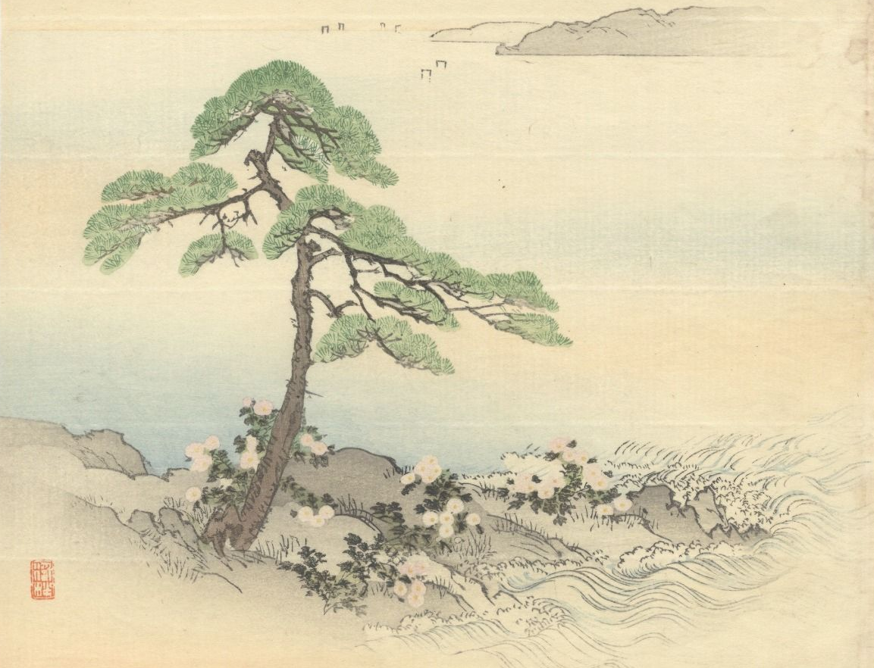
Art à la Japan
Catching the eye
Key elements of visual design:
Movement & rhythm
Balance: symmetry vs asymmetry
Similarity & harmony vs contrast & variety
Perspective & proportion
Repetition & continuation
Unity: wow factor
Japan-specific additions:
“Wabisabi” (侘び寂び – literally “forlorn rusticism”): austere, naturalistic, often hard-worn beauty and elegance
Top-right to bottom-left traditional reading
  It is self-evident that nothing concerning art is self-evident.
- Theodore Adorno (1969)

Slide 10
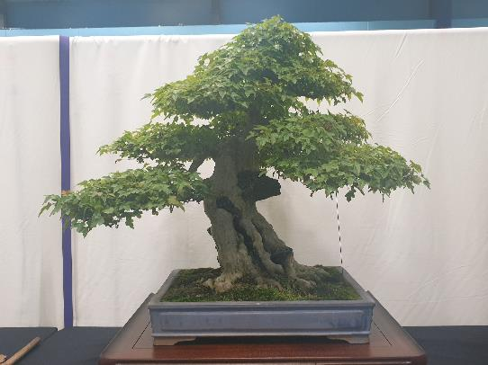
Drama & Perspective
What makes a tree stand out?
Taper (again!)
  Taper appears stronger from viewpoint at base of tree
Pot: picture-frame for tree
  “Heavy” earthenware vs “light” glazed
  Depth ≈ trunk thickness; width ≈ 2/3 canopy height (tall tree) or width (wide tree)
  Style: heavy vs light, plain vs ornate
Use of negative space
  …Often in imitation of wind-flow or trunk death in full-scale trees
Scaled-down decorations
  Moss “grass”, accent plants, rocks (“suiseki”)
Well-defined “front”
  Style is firmly established
  Sense of strength or movement captured
  Clear view of lower trunk
  No crossed branches
  Tree’s “centre of mass” is in middle of pot

Slide 11
Flaws
What gives the game away?
Obvious tool marks
  …Including wire scarring
Excessive symmetry
  …Especially handlebar branches
  Asymmetry is a common theme in Japanese gardening!
“Reverse taper”
Unusual “habit” for species / genus
  Google for pictures of wild tree to get ideas!
  This rule is frequently ignored: e.g. small shrubs portrayed as large trees, boringly-shaped species made interesting, unrealistic pads
Dead leaves and (unwanted) deadwood
Weak / immature-looking branches
  Suckers
  Congested nodes
  Under-slung / elbow branches
  Lack of clear “leader” (dominant trunk / branch)

Slide 12
Bonsai Styles
The most common four archetypes of… thirty? Really?!?
Formal Upright
Cascade
Strong, proud, “yang”
Pot: unglazed earthenware; simple shape; bulging
Can be hard to develop taper, especially on conifers
Flowing, falling
Pot: deep to make space
“Half-cascade” runs to base of pot; “cascade” goes below that
Informal Upright
Literati
Relaxed, elegant, “yin”
Pot: glazed; fluting; flowery
Broad range of possible shapes
Basically the default style!
Solitary, melancholy, bleak
Trunk: bare, ruptured, calligraphic
Pot: small to emphasise plant’s extravagant loneliness
Style derived from woodcuts in classic Chinese drawing guide

Slide 13
Appendices
Miscellaneous Technical Notes

Slide 14
Repotting step-by-step
✓
fingers
Regular repotting – often back into the same pot! - helps limit tree size via “root-to-shoot ratio”
1. Prepare pot
Pick a (tentative) pot
Scrub clean
Staple mesh over holes
Add guy wires
2. Prepare tree
Remove from pot
Clean off soil surface
Dig down to expose nebari
Choose “front” if not already clear
Dig up / in to define root-ball
Untangle lateral roots where poss. (esp. girdling roots)
Clear any growth from lower trunk
Spray with water if starting to dry!
3. Insert tree into pot
Add shallow layer of soil to base
Place root ball in pot and pack soil around
Compress soil to “brownie” hardness
Pull guy wires over root ball, twist pairs together tightly, and trim to 3-4 twists
Cover with dried, grated, rehydrated sphagnum and compress surface
Sprinkle with grated acrocarpous (upward-growing) moss
✗
Prone to snapping!
✗
Prone to snapping!

